Slide 1
Clinical Data Wrangling: Active/Didactic Learning
Ted Laderas, Nicole Weiskopf and Eilis Boudreau
@tladeras | http://laderast.github.io
Slides:

Slide 2
Introduction: Ted Laderas
Assistant Professor
Division of Bioinformatics and Computational Biomedicine, Medical Informatics and Clinical Epidemiology, Oregon Health & Science University
Research Interests
Education (active learning)
Interactive Visualization
Drug Sensitivity/Resistance in Cancer

Slide 3
Overview
Why clinical data wrangling?
Why the workshop?
What is the workshop?
Components of the workshop
Extensions
Availability

Slide 4
Motivation: Why?
Research is multi-disciplinary
Need for Translational Research Workforce
Bridge gaps between computational biology and clinical realms

Slide 5
Clinical Data Wrangling Workshop
Data Exploration and Availability Assessment
Audience: incoming informatics graduate students
Designed for both clinical and bioinformatics students
Assumes no expertise with R/RStudio
Introduce students to data quality issues with clinical data
ETL and Curation
ETL Quality Assurance
Fitness for Use Assessment

Slide 6
Learning Objectives
Understand the usefulness and challenges with working with clinical data
Understand the biology of sleep and sleep apnea and how the biology informs the covariates measured in the Sleep Heart Health Study
Learn Exploratory Data Analysis techniques and use them to inform/analyse model building
Evaluate a predictive model (logistic regression) using simple diagnostics.
Communicate your findings in a team setting.

Slide 7
Challenges: Where to get data?
Partnership with National Sleep Research Resource
http://sleepdata.org
Sleep Heart Health Study data
~5700 patients, 3000 covariates
Reduced to 17 covariates
Requires students to sign data use agreement

Slide 8
Workshop is split over multiple days
Day 1:
Logistics
Intro to sleep data
Intro to data reuse and data quality
Exploratory Data Analysis
Intro to logistic regression
Day 2:
Logistic regression Q&A
Assignment: Is Race appropriate?
Day 3:
Is hypertension appropriate?
Final presentation prep
Day 4:
Final Presentation by groups

Slide 9
Social Learning
Introduce students to each other
Code of Conduct
Psychological Safety
Diverse teams

Slide 10
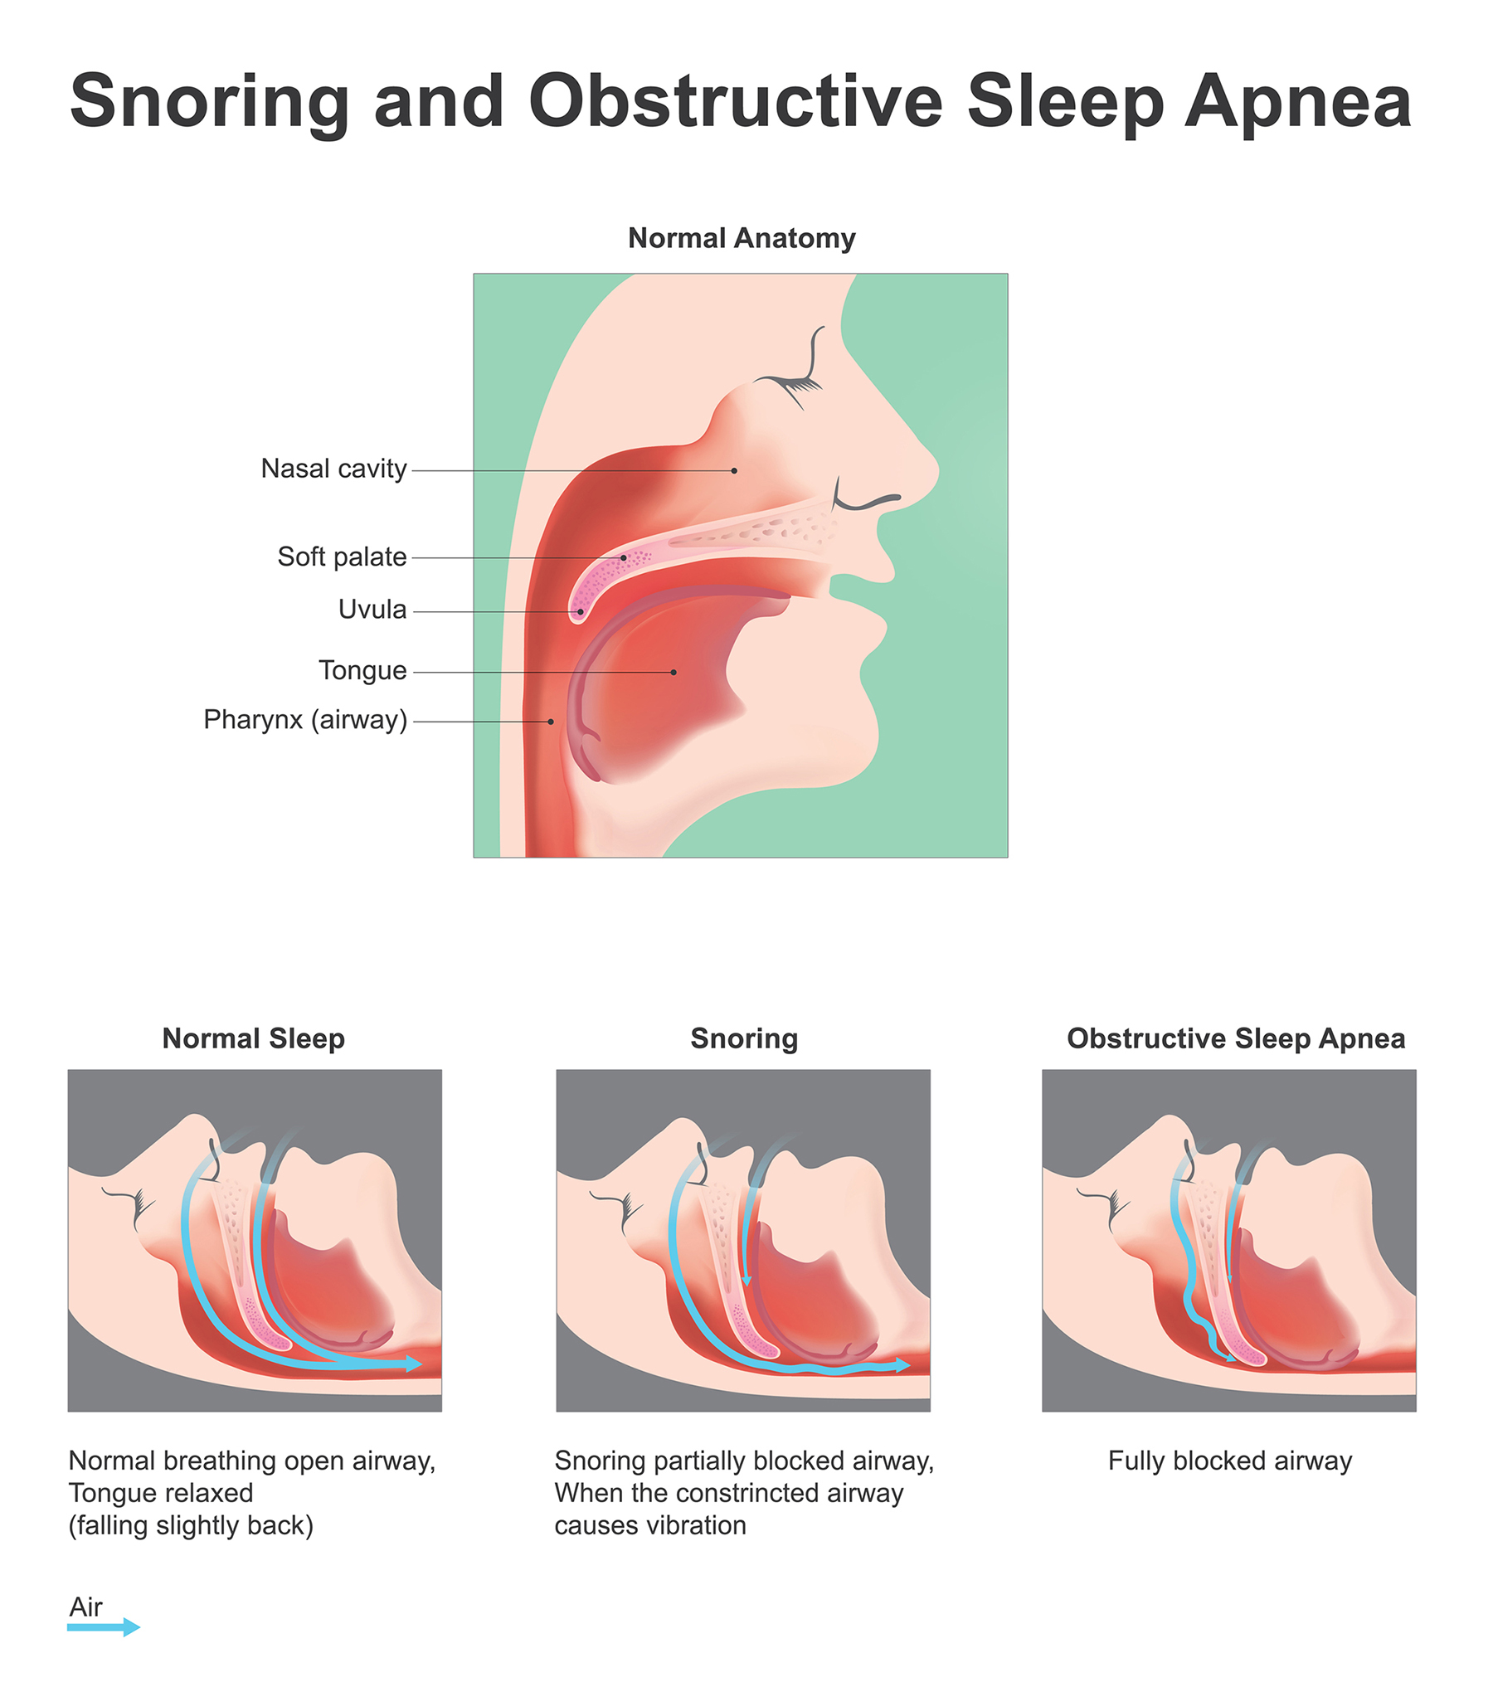
Lecture: Background about Sleep
Eilis Boudreau: Sleep Neurologist
How we think cardiovascular disease is related to sleep disorders
How we measure sleep disorders
https://www.sleepwell.org/snoring/

Slide 11
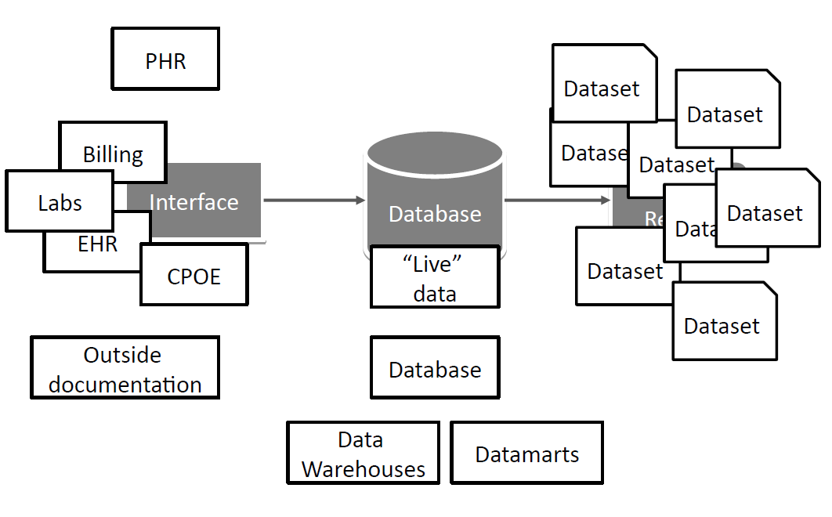
Lecture: Data Reuse and Data Quality Issues
Nicole Weiskopf: EHRs and Data Quality
Expose students early on to data quality issues
Plusses/Minuses of Data Reuse
Biases of Clinical Data

Slide 12
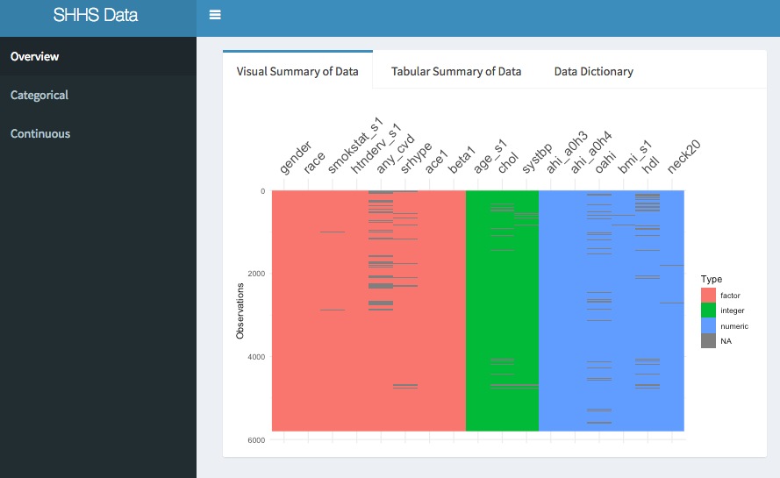
Exploratory Data Analysis
Shiny app (burro) that lets students explore dataset
Code-less, assumes no coding expertise
Can be deployed as a website

Slide 13
Burro: Categorical Analysis

Slide 14
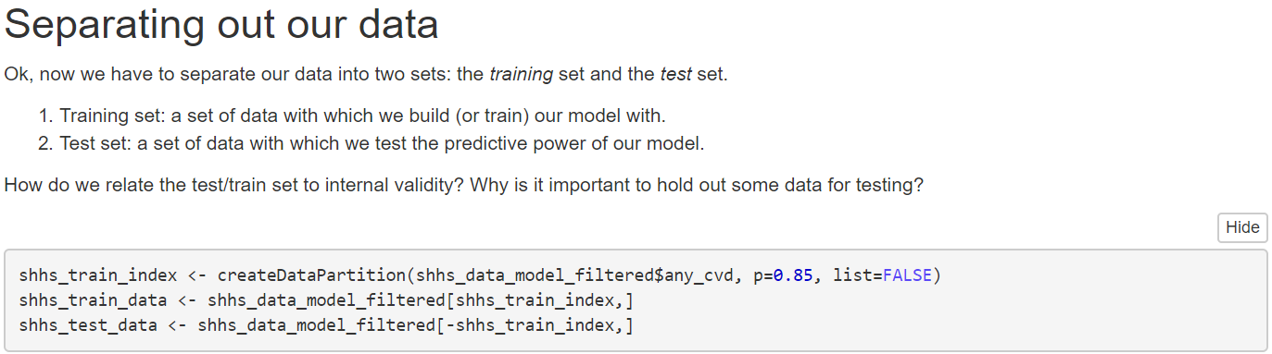
Building Predictive Models by Making Decisions
Rstudio notebook: logistic regression
Simple data cleaning/impact on dataset
Assessing predictions
Test/Train Datasets

Slide 15
Iterating your model: what about Race/Hypertension?
Understanding the contributions of race
How is it defined?
How does our population compare to the US?
Understanding including hypertension as a variable
Medication Lists
Systolic blood pressure

Slide 16
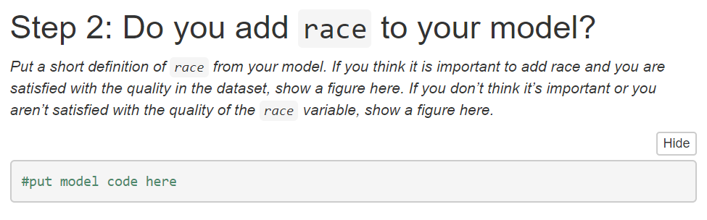
Final Analysis: Making and Documenting Critical Decisions
Final presentation is an R Notebook
What variables did you use at each step?
Why did you include them?
What were your values?
How did that affect your results?

Slide 17
Challenges: There is no right answer
Students wanted to choose an “optimal” threshold without values
Understanding importance of how a clinical test would be used

Slide 18
Outcomes
Good opportunity for clinical/bioinformatics students to meet
Sets the tone for our program
Currently assessing impact on students

Slide 19
Extensions
Data Science for MDs/PhDs
Reframe as clinical case
Data Scavenger Hunts

Slide 20
Acknowledgements:
T15 NLM Training Supplement Grant: 5T15LM007088
Susan Redline/Dan Mobley at NSRR
The Carpentries
Incoming class of 2018 informatics students

Slide 21
Interested?
Keep in touch! We want others to utilize the workshop!
laderast@ohsu.edu | @tladeras | http://laderast.github.io
Burro: http://laderast.github.io/burro
Workshop: http://laderast.github.io/clinical_data_wrangling/

